Slide 1

Introduction to Deno
A secure runtime for JavaScript and TypeScript

Slide 2
What is it?
From the website: Deno is a simple, modern and secure runtime for JavaScript and TypeScript that uses V8 Engine (same as Node) and is built in Rust.
Secure by default. No file, network, or environment access, unless explicitly enabled.
Supports TypeScript out of the box.
Ships only a single executable file.
Has built-in utilities like a dependency inspector (called “deno info”) and a code formatter (called “deno fmt”).
Has a set of reviewed (audited) standard modules that are guaranteed to work with Deno: deno.land/std

Slide 3
Why do we care?
Sounds like Node.js? Same person (Ryan Dahl) who created Node.js created Deno!
Both Javascript and Typescript can be used outside of the browser. No need to transpile, Deno works with Typescript.
Deno has a standard library.
Deno can use WebAssembly.
No package.jsons needed! (most controversial change but more on that later)
Enforces styling/auto-linting of Typescript at runtime!
Just made it to V1.0+ this year so it's (mostly) ready for production.

Slide 4
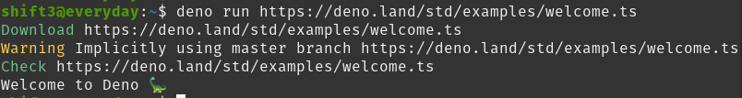
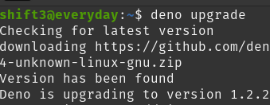
Getting Started - Install and Example

Slide 5
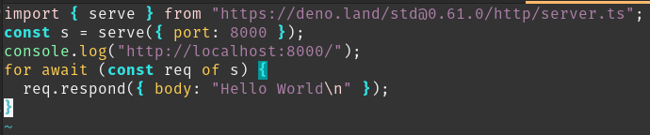

Getting Started - Part 2 (Simple web server)
Notes:
https://deno.land/std@0.64.0
https://deno.land/std@0.64.0/http/server.ts

Slide 6
Getting Started - Part 3 (More complicated)
Other example programs (all based on https://deno.land/manual):
Making an HTTP request
Reading Files
TCP server
An implementation of the unix "cat" program
File server
TCP echo server
Run subprocess
Inspecting and revoking permissions
Handle OS Signals
File system events
Notes:
https://deno.land/manual

Slide 7


Example: REST API
How to build a RESTFUL API with deno?
Deno (duh)
OAK: A middleware framework for Deno's net server
PostgreSQL: The World's Most Advanced Open Source Relational Database
+
+

Slide 8
WebAssembly - A quick look
Deno/Node.js/Browsers execute JavaScript on C/C++ based runtimes.
Allows developers to use compiled languages and libraries on the web (and everything else)!
Most modern day browsers already support WebAssembly as a standard.
Example:
LISP interpreter in the browser (Javascript bindings into C -> LISP)!
https://github.com/michaelachrisco/ToyLisp
Warning: This is a talk in itself!

Slide 9
Deno + WebAssembly
Deno supports WebAssembly out of the box.
C/C++/Rust/Go and many more work with Deno bindings.
Most modern day browsers already support WebAssembly as a standard.
Practical Example:
Creating web-based GUIs for desktop applications with Rust and Deno.
Heavily based on work here:
https://github.com/webview/webview_deno
Warning: This is a talk in itself!

Slide 10
Conclusions: Pros of Deno
Deno has some great ideas:
Supports both Javascript and Typescript out of the box.
Has easy to use bindings for WebAssembly.
Works very well on server-side Typescript.
Core libraries seem to be the most stable part of the system.
I found year old projects still working on the Deno core API.

Slide 11
Conclusions: Not-so Pros of Deno
3rd party Deno Libraries need work:
When doing research for this presentation, there were an abundant amount of libraries doing the same things (REST API, ORMS, etc…) with varying degrees of longevity.
Issues with installing 3rd parties that do not support the most recent version of Deno.
Notes:
fs events ops (auto update deno/node)

Slide 12
Conclusions: Opinions
You will either love or hate the import process in Deno. It’s very similar to how Go deals with importing its libraries.
When dealing with import errors, found myself forking and adding fixes to own github repositories.

Slide 13

Youtube Resources
10 Things I Regret About Node.js - Ryan Dahl - JSConf EU
https://www.youtube.com/watch?v=M3BM9TB-8yA
Deno in 100 seconds: https://www.youtube.com/watch?v=F0G9lZ7gecE
(6 hours) Deno Course - Better than Node.js? - https://www.youtube.com/watch?v=TQUy8ENesGY

Slide 14
References and Resources
Logo from https://github.com/denolib/high-res-deno-logo/blob/master/deno_hr_circle.svg
Main website: https://deno.land/
Documentation and example programs: https://deno.land/manual
FreeCodeCamp more in depth 6 hour talk: https://www.youtube.com/watch?v=TQUy8ENesGY
Deno crash course with Rest API: https://www.youtube.com/watch?v=NHHhiqwcfRM&t=5s
Oak REST API: https://github.com/oakserver/oak
Other Oak REST API: https://medium.com/javascript-in-plain-english/building-crud-apis-using-deno-and-oak-9f71ec106b0e

Slide 15


Questions?

Slide 16

CC Dino pics!
https://search.creativecommons.org/search?q=dinosaur

